Slide 1

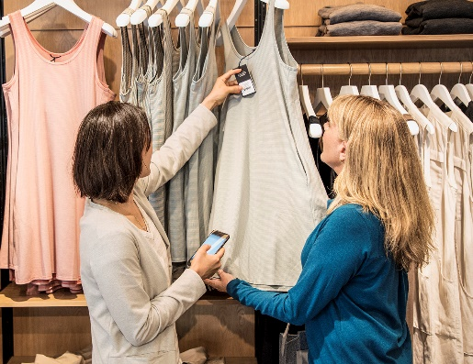





Build end-to-end IoT solutions Device provisioning at scale
Pamela Cortez
Microsoft Azure IoT
Notes:
Focus on improving the developer experience with our products, technical readiness, and developer communities

Slide 2

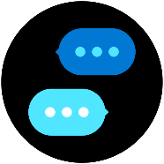



Build end-to-end IoT solutions – Workshop Series
https://aka.ms/IoT-online-workshop
Transform your business with IoT
Devices and device communication
Device provisioning at scale
Messaging processing, analytics, and business integration
Work with Azure IoT Edge
Notes:
In our first session, we’ll cover how Azure IoT is being adopted by enterprises and the problems that can be solved when you enable real-time digital feedback loops through the cloud. In the first labs, you’ll get started with the Azure portal, creating a dashboard and resource group. You’ll then explore the Azure services that will be used to provision and connect devices (IoT Hub and IoT Hub Device Provisioning Service)
Devices and device communication
In this session, we’ll take you through preparing a development environment you can use to build your IoT solution, both on the Azure cloud side and for your local work environment. For the labs, we’ll walk through evaluating a monitoring solution prior to full-scale implementation; you’ll connect a simulated IoT device that includes temperature and humidity sensors to IoT Hub; and you’ll verify that device telemetry is being received.
Device provisioning at scale
This portion of the workshop scenario walks through a hypothetical asset-monitoring solution that requires an IoT device with sensors for tracking location, temperature, and pressure included in product transport boxes. You’ll learn how you can use Azure Device Provisioning Service to enroll many devices automatically and securely.
Messaging processing, analytics, and business integration
You’ll write code to send continuous telemetry to an IoT Hub that will use Azure Stream Analytics and a built-in machine learning model to warn of anomalies. Power BI will be used to visualize the data stream, and you’ll create an event subscription within Azure IoT Hub to set up Event Grid integration that will trigger a logic app to send an alert.
Work with Azure IoT Edge
With large amounts of data being collected and urgent time responses needed, you’ll want to bring the intelligence to the edge for processing data and only send the important data to the cloud. Working through the exercises, you will setup an IoT Edge gateway; develop, deploy, and debug a custom module on Azure IoT Edge; and then run an IoT Edge device offline and in a restricted network.

Slide 3
Device provisioning at scale
Overview of Device Provisioning Service
Developer Tools
Lab: Provision IoT devices securely and at scale with Device Provisioning Service
Create an Azure IoT Hub
Create DPS resource & group enrollment. Provision device with x.509 certificate attestation
Send Device Telemetry to IoT Hub
Deprovision
Developer Resources & Getting started

Slide 4
Biggest challenges with devices
Open source SDKs
IoT Hub
Device Provisioning Service
Developing and maintaining a connected,
secure, serviceable and supportable device
Integrating devices and their data into cloud services
Out-of-the-box provisioning of devices at scale
But what about device management over the long-term?

Slide 5
IoT Device Management Lifecycle
Replace or decommission devices after failure, upgrade cycle or service lifetime
Group devices and control access according to your organization's needs
Retire
Plan
Monitor device inventory, health and security while providing proactive remediation of issues
Securely authenticate devices, on-board for management and provision for service
Monitor
Provision
Configure
Provide updates, configuration and applications to assign the purpose of each device

Slide 6
Why provisioning is hard today
Solutions must have per-device revocable access
Provisioning is a manual process
Initial configuration can become irrelevant between manufacturing and deployment
Device supply chains are complex

Slide 7
Device Provisioning Service (DPS) brief feature overview
Cross-region, cross-subscription DPS→IoT Hub support for geo-sharded and multitenancy solutions
Automatic re-provisioning supports the device lifecycle
Factory reset
Migration
Flexible, targeted device assignment logic
Static assignment for when you know the hub
Evenly weighted for round-robin assignment
Lowest-latency for geo-shared applications
Custom assignment logic for advanced scenarios
Manage devices at as a group or as individuals
Based on authentication type
Multiple auth methods supported
Symmetric keys for getting started
TPM endorsement key for secure storage
X.509 certificates for maximum security
Cross-platform support through open source SDKs
Edge device support

Slide 8
A Selection of Scenarios
Initial connection
Load balancing
Ownership based
Location based
Re-provisioning
Zero-touch provisioning to a single IoT solution
Across multiple hubs
Connecting devices to their owner’s IoT solution based on sales transaction data
Connecting a device to the IoT hub with the lowest latency
Based on a change in the device, e.g. change of ownership

Slide 9


Microsoft IoT
Broadest portfolio
Industry Solutions
Manufacturing
Retail
Agriculture
Energy
Smart Cities
Healthcare
Transportation
Azure IoT Central
Dynamics Connected Field Service
IoT app services
Azure IoT Hub
Azure IoT Hub Device Provisioning Service
Azure Digital Twins
Azure Time Series Insights
Azure Maps
Azure Security Center for IoT
Azure Stream Analytics
Azure Cosmos DB
Azure AI
Azure Cognitive Services
Azure ML
Azure Logic Apps
Azure Active Directory
Azure Monitor
Azure DevOps
Power BI
Azure Data Share
Azure Spatial Anchors
Azure services for IoT
Azure RTOS
Azure Sphere
Azure IoT Device SDK
Azure IoT Edge
Azure Stack Edge
Windows IoT
Azure Certified for IoT—Device Catalog
Azure Stream Analytics
Azure Storage
Azure ML
Azure SQL
Azure Functions
Azure Cognitive Services
IoT & Edge Device Support

Slide 10
Provisioning
Provisioning Setup = Pre-registration + Device Assignment
Device Provisioning = Runtime assignment + Initial Set up

Slide 11
Azure IoT Hub
Bi-directional communication
Enterprise scale & integration
End-to-end security
Millions of Devices
Multi-language, open source SDKs
HTTPS/AMQP/MQTT
Send Telemetry
Receive Commands
Device Management
Device Twins
Queries & Jobs
Billions of messages
Scale up and down
Declarative Message Routes
File Upload
WebSockets & Multiplexing
Azure Monitor
Azure Resource Health
Configuration Management
Per Device Certificates
Per Device Enable/Disable
TLS Security
X.509 Support
IP Whitelisting/Blacklisting
Shared Access Polices
Firmware/Software Updates

Slide 12

Provision Challenges
Connection String 3
Connection String 1
Connection String 2
IoT Devices
IoT Hub

Slide 13

IoT Hub Device Provisioning Service
A helper service for IoT Hub that enables zero-touch, just-in-time provisioning to the right IoT hub without requiring human intervention.
IoT Devices
IoT Hub Device Provisioning Service
IoT Hub

Slide 14
Provisioning with IoT Hub Device Provisioning Service
Pre-register device enrollment info
IoT Hub
IoT Hub
Device Provisioning Service
Register new device, populate initial config
IoT Hub Connection String
IoT Hub
IoT Hub
Business logic
IoT Hub Connection String
IoT Hub
Device telemetry
“where do I go”
Device authentication
Device telemetry
Establish connection
Device
Initial configuration
…etc
Insights
Notes:
Let’s go over how provisioning works with a device provisions via IoT Hub Device Provisioning Service . Only one IoT hub will shown for clarity, but the process works with up to 10 hubs linked to a single DPS
[each numbered point is a literal click stop]
After the device is manufactured, the device enrollment information is added to the DPS. This is the only manual step in the process as part of the provisioning set-up
At some point afterwards, which could be a day or it could be several months, the device goes online and connects to DPS to find its IoT solution home.
DPS and the device go through an authentication handshake using the device identity info. DPS verifies the device’s identity
DPS registers the device to IoT hub and populates the initial desired device state
IoT hub returns IH connection info for the device
DPS gives the device its IoT Hub connection info
The device now establishes a connection with IoT hub…
…and retrieves its initial config from IoT hub and makes any changes/updates, as needed
The device starts sending telemetry to IoT hub
The telemetry is consumed by the backend business logic
The business logic produces insights which are transformed into commands to the device to operate more efficiently
The telemetry/insights loop continues for the rest of the device’s useful life

Slide 15
Re-Provisioning at Scale
IoT Hub
East US
Device
Provisioning request
Devices assigned to IoT Hub East US
Changes devices assignments to IoT Hub West US
Device
IoT Hub
West US
Device
IoT Hub
East Europe
Device
Device
IoT Hub
West Europe
……millions

Slide 16
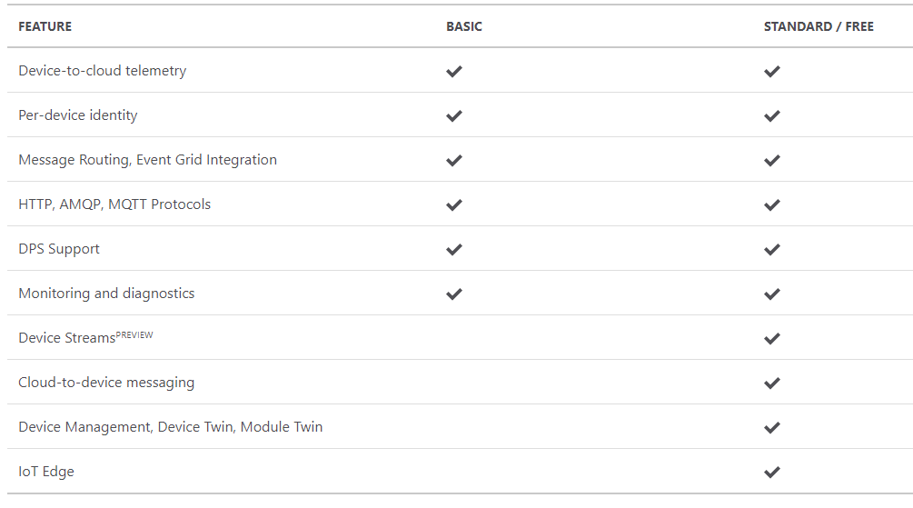
IoT Hub & Device Provisioning Service Support
Easy upgrade from basic to standard tier.
Only standard allows cloud-to-device commands, device twin operations and IoT Edge
Learn about IoT Hub scaling

Slide 17
Device provisioning at scale
Overview of Device Provisioning Service
Developer Tools
Lab: Provision IoT devices securely and at scale with Device Provisioning Service
Create an Azure IoT Hub
Create DPS resource & group enrollment. Provision device with x.509 certificate attestation
Send Device Telemetry to IoT Hub
Deprovision
Developer Resources & Getting started

Slide 18
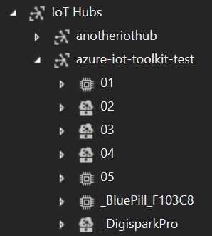
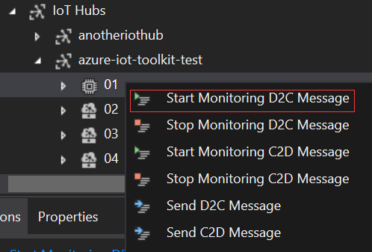


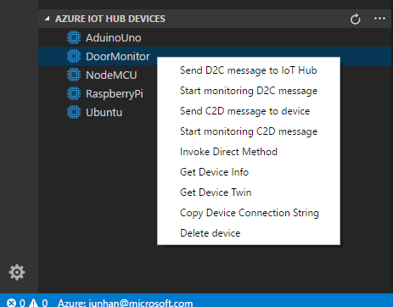
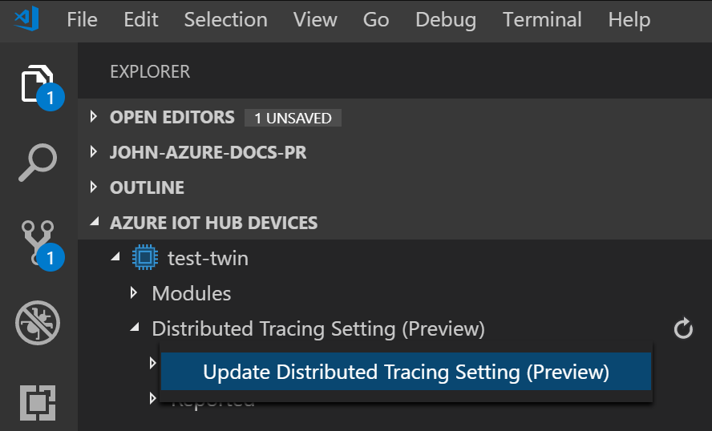

Azure IoT Hub tools
Cloud Explorer for VS 2017/2019
VS Code IoT Hub Toolkit
Azure IoT CLI Extension
https://github.com/Azure/azure-iot-cli-extension.

Slide 19
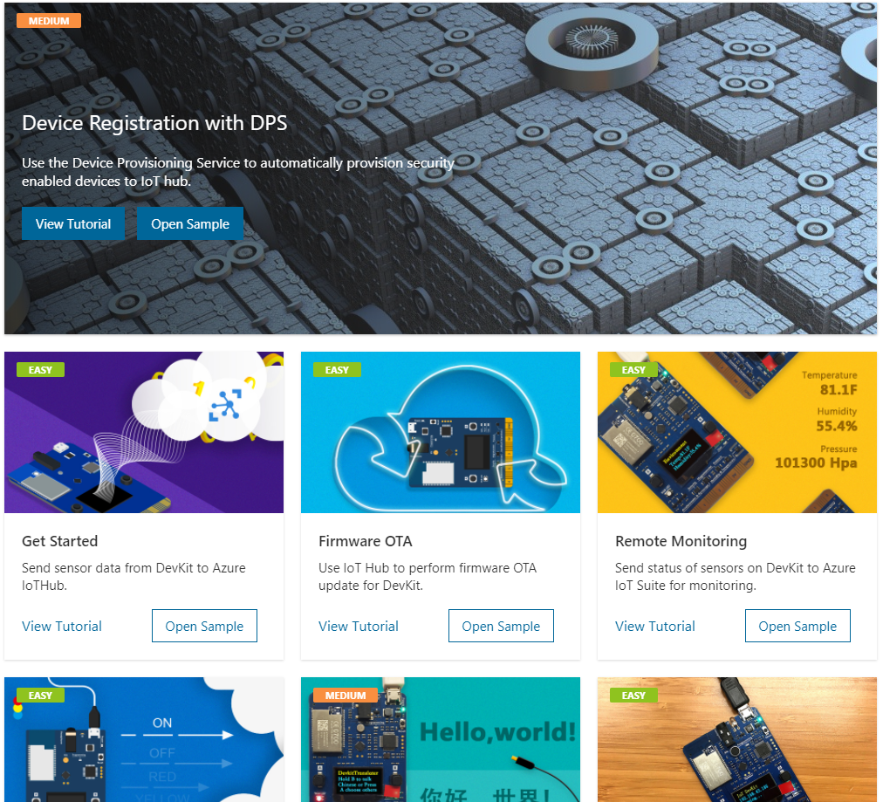
Azure IoT Device Workbench for VS Code
Support Certified Azure loT Devices
Start from Solution Gallery or custom IoT project
Code, build, deploy and debug

Slide 20
Device provisioning at scale
Overview of Device Provisioning Service
Developer Tools
Lab: Provision IoT devices securely and at scale with Device Provisioning Service
Create an Azure IoT Hub
Create DPS resource & group enrollment. Provision device with x.509 certificate attestation
Send Device Telemetry to IoT Hub
Deprovision
Developer Resources & Getting started

Slide 21
Device provisioning at scale
Overview of Device Provisioning Service
Developer Tools
Lab: Provision IoT devices securely and at scale with Device Provisioning Service
Create an Azure IoT Hub
Create DPS resource & group enrollment. Provision device with x.509 certificate attestation
Send Device Telemetry to IoT Hub
Deprovision
Developer Resources & Getting started

Slide 22
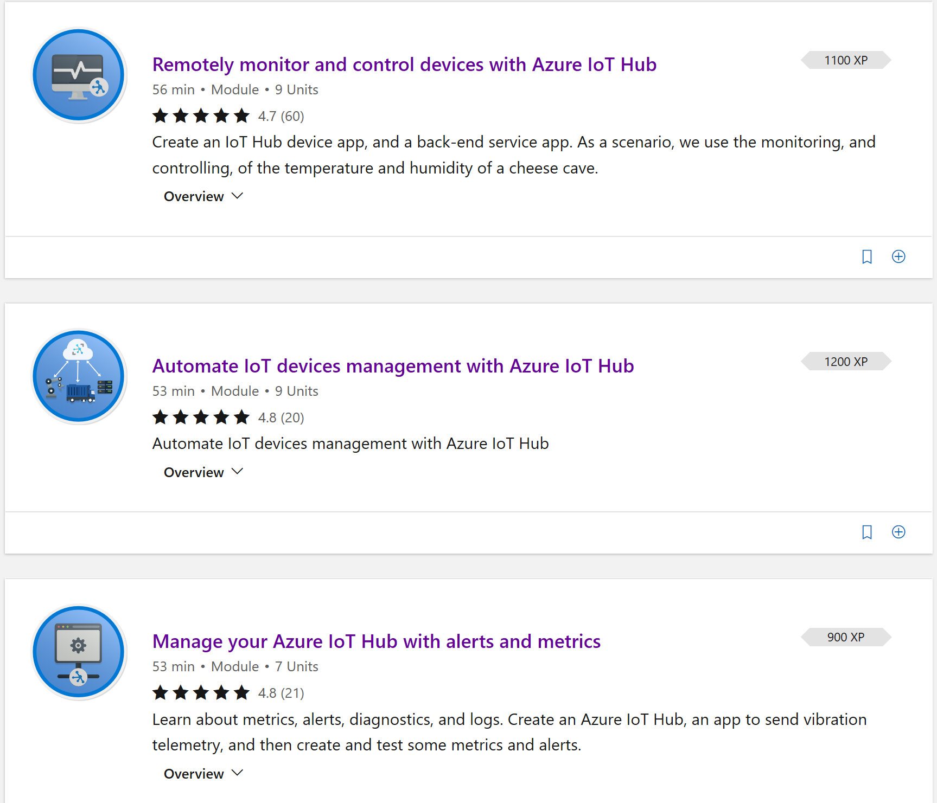


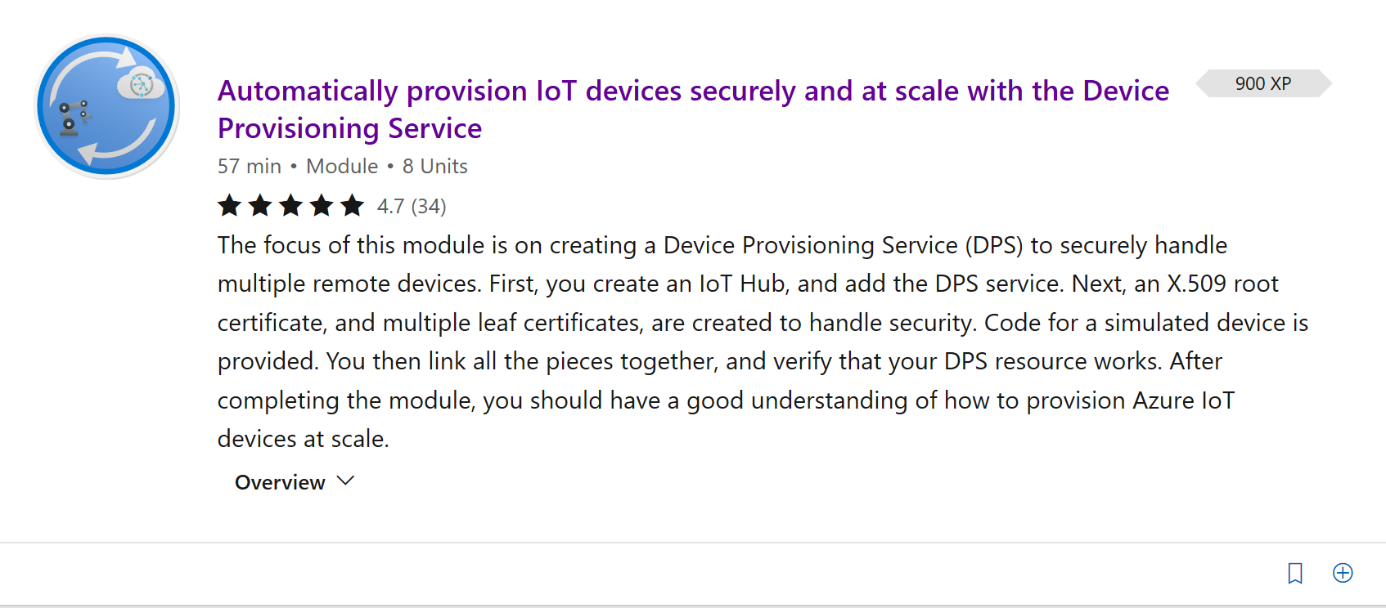
Get Started Now!
https://aka.ms/SecurelyConnectDevicesLearningPath
https://aka.ms/IntroAzureIoTLearningPath
Sign-up for Build end-to-end IoT solutions – Workshop Series
https://aka.ms/IoT-online-workshop
Transform your business with IoT
Devices and device communication – IoT Hub
Device provisioning at scale – Device Provisioning Service
Messaging processing, analytics, & business integration – Time Series Insights, Event Grid, Azure Stream Analytics
Work with Azure IoT Edge – IoT Edge

Slide 23
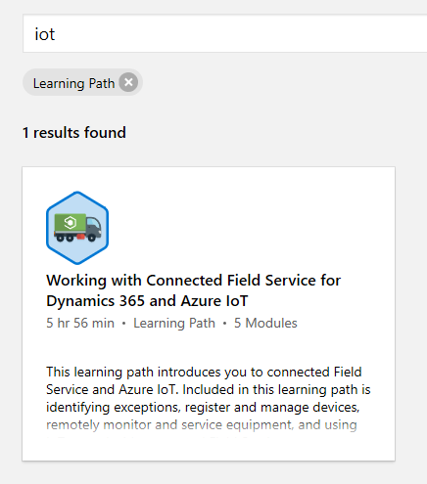
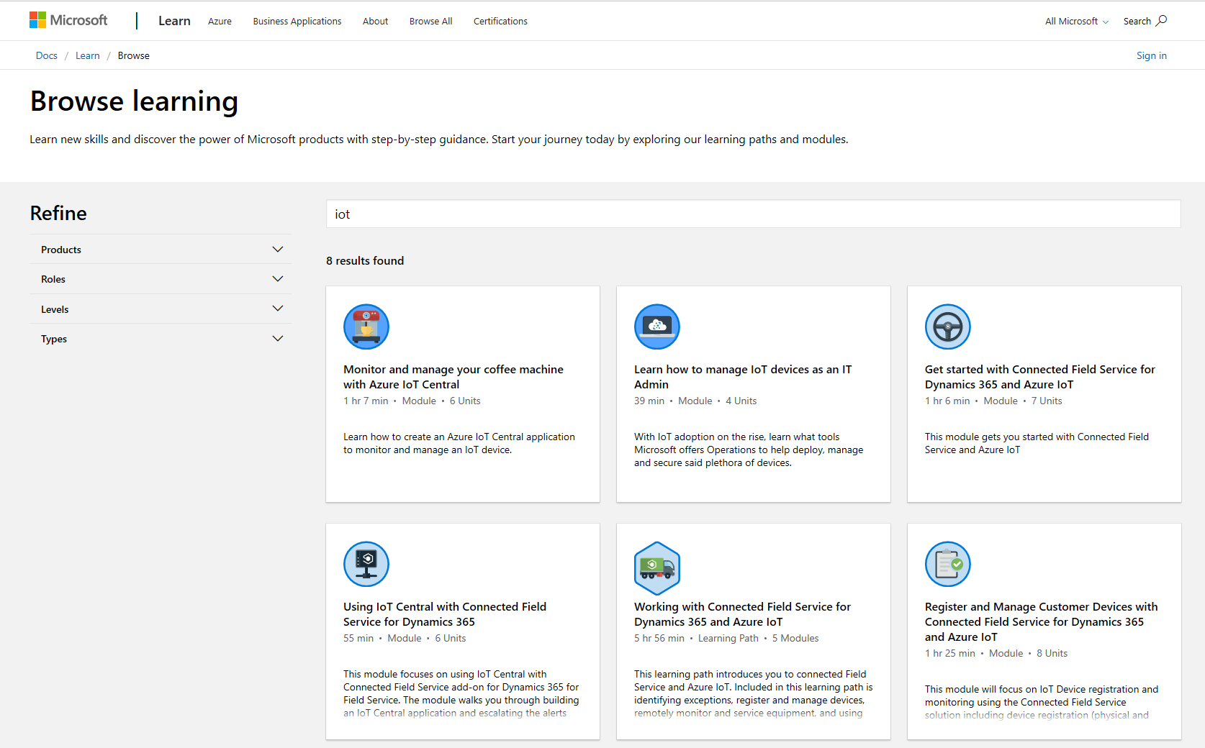
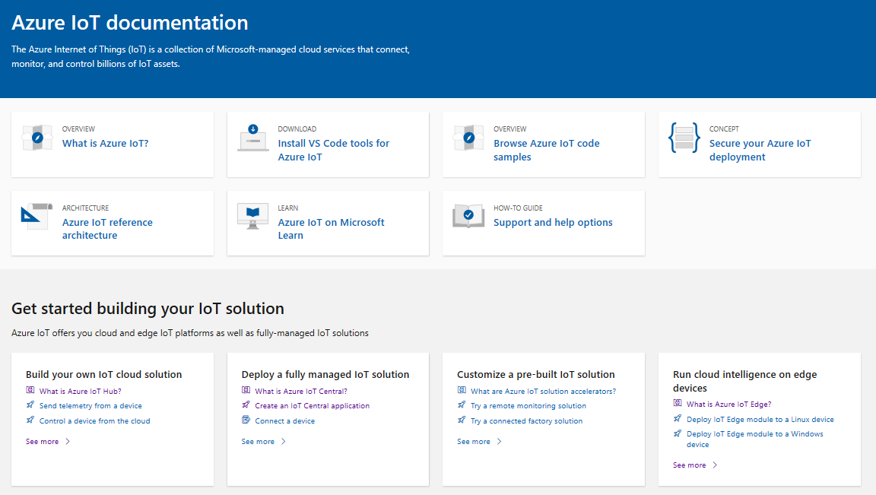
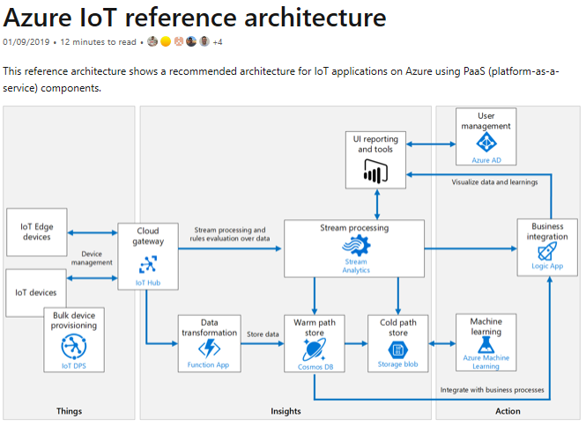
Learn how to get started with IoT
Building IoT solutions with Azure Developer Guide https://discover.microsoft.com/azure-iot-building-solutions-dev-guide/
Microsoft Learn learning paths
http://aka.ms/mslearniot
Microsoft Learn is a newer learning platform that offers sandbox online training
Azure IoT Reference Architecture Guide https://docs.microsoft.com/azure/architecture/reference-architectures/iot/
This reference architecture shows a recommended architecture for IoT applications on Azure using PaaS (platform-as-a-service) components.
Azure IoT Docs
Getting Started, Tutorials, How-to guides, reference, whitepapers

Slide 24
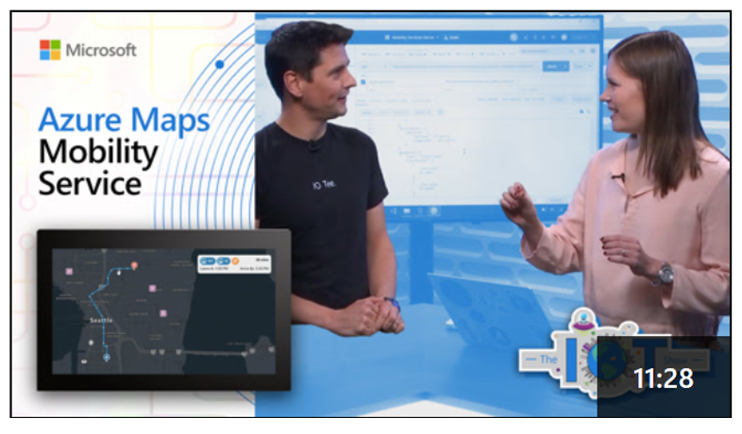
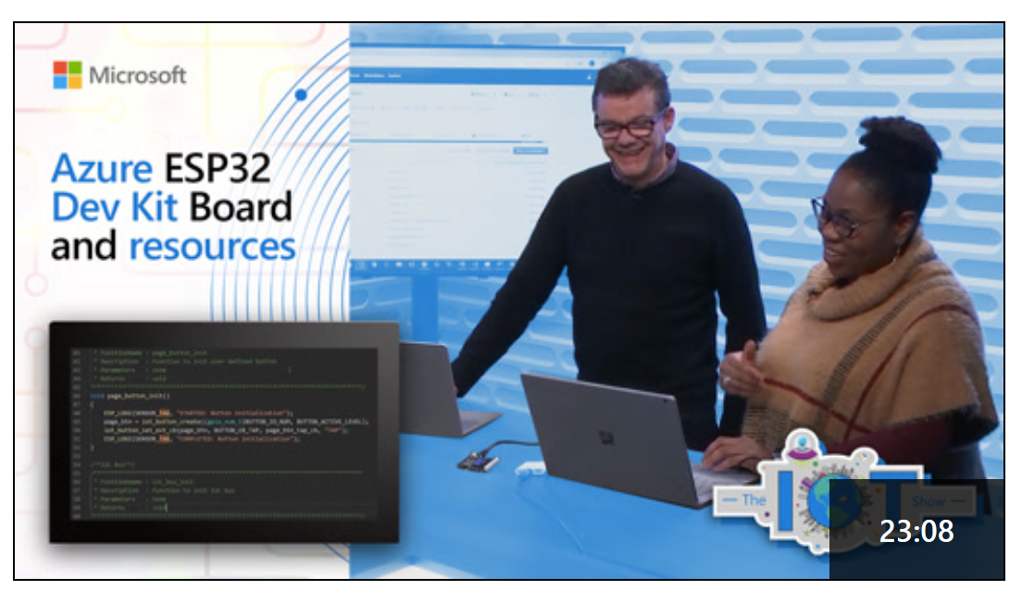
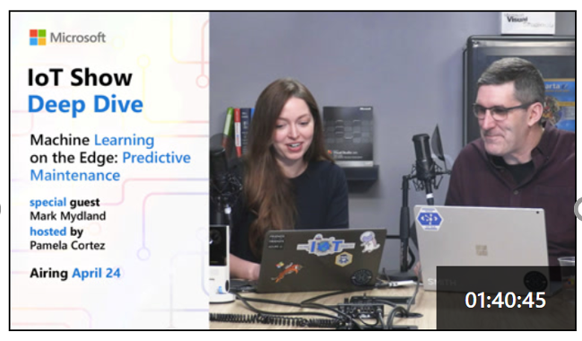
IoT Show
New video every Monday (Deep Dives on Wednesdays!) Subscribe to stay up-to-date with latest Microsoft IoT announcements, product and features demos, customer and partner spotlights, top industry talks, and technical deep dives with IoT Show! aka.ms/IoTShow

Slide 25
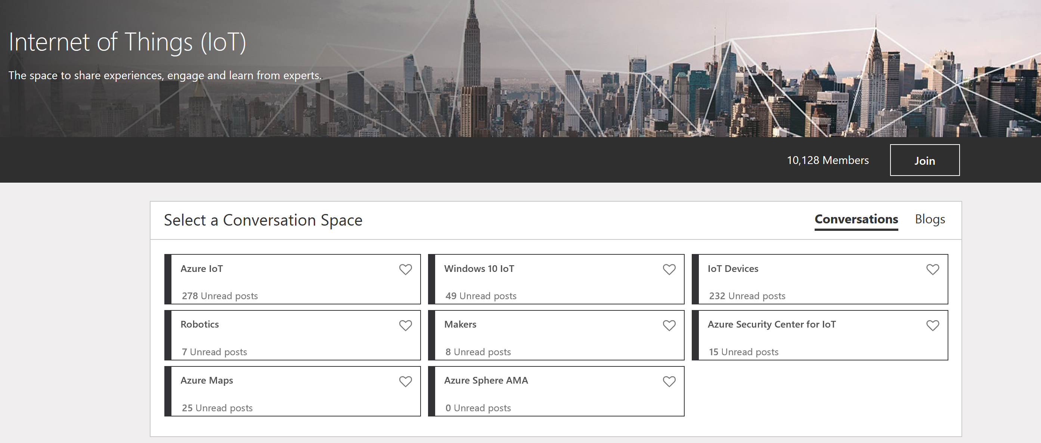
IoT Tech Community
Community forum to stay to update on latest announcements, connect with other developers, share your projects, and ask questions!
Fast growing vibrant community
One Microsoft IoT voice
http://aka.ms/iottechcommunity

